Slide 1

Office Management System: A Cisco Packet Tracer Project
Welcome to our presentation on designing an enterprise-level network. This project showcases a robust multi-office network, built and simulated using Cisco Packet Tracer.
We will explore its architecture, key components, and the configurations that ensure seamless communication across all departments.

Slide 2
🗺️ Area-wise Device Distribution
🟪 Reception Area (Switch0)
PCs: 4 (PC0 – PC3)
IP Phones: 3 (Phone0 – Phone2)
Printers/Servers: None
Connected Router: Router5
Subnet: 194.168.10.0/24
🟪 Office 1 Area (Switch4)
PCs: 5
IP Phones: 1 (Phone5)
Printers: 1 (Printer1)
Connected Router: Router4
Subnet: 193.168.10.0/24
🟪 Office 2 Area (Switch1)
PCs: 6
IP Phones: 1 (Phone3)
Printers: 1 (Printer0)
Connected Router: Router5
Subnet: 195.168.10.0/24
🟪 Office 3 Area (Switch2)
PCs: 8
IP Phones: 1 (Phone4)
Connected Router: Router6
Subnet: 196.168.10.0/24
🟪 Security Area (Switch3)
PCs: 2 (PC17, PC18)
IP Phones/Printers: None
Firewall: Connected to ASA 5505 (ASAD)
Router: Router6
Subnet: 197.168.10.0/24
🟦 Server Room Area (Switch5)
PCs: 1 (PC25)
Servers: 3 (Server0, Server1, Server2)
Connected Router: Router4
Subnet: 192.168.10.0/24

Slide 3
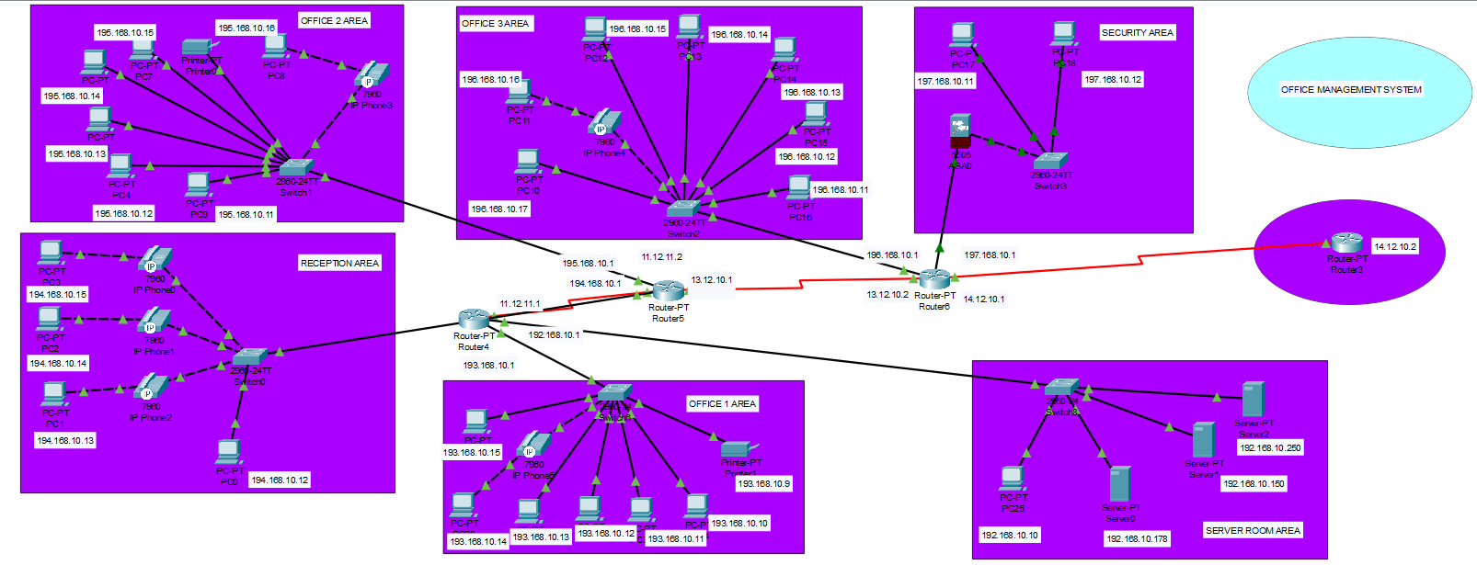
Project Overview: Building a Multi-Office Network
Our project demonstrates a comprehensive office network. It includes Office 1, 2, and 3, a dedicated Security Area, a Server Room, and integrated printers. These are all interconnected using routers and switches.
We implemented static IP addressing for devices and dynamic routing via RIP v2 for efficient data flow.

Slide 4

Why Cisco Packet Tracer?
Cisco Packet Tracer is an indispensable tool for network design.
Realistic Simulation
It accurately simulates Cisco routers, switches, and end devices. This provides a true-to-life environment for network testing.
Protocol Testing
We can test routing protocols, IP communication, and troubleshoot effectively. This ensures network stability and performance.
Academic & Real-World Use
It's ideal for both academic learning and simulating realistic projects. This bridges the gap between theory and practical application.
Logic Verification
Packet Tracer helps verify IP addressing, inter-network connectivity, and complex routing logic. This confirms the network's integrity.

Slide 5
Key Network Components
Our network design incorporates a variety of essential devices to ensure comprehensive connectivity and functionality.
💻 PCs
Office PCs in each designated area, providing user access.
🖨 Printers
One dedicated printer located strategically in Office 2 for shared use.
☎ IP Phones
Voice communication devices connected alongside some PCs, integrated into the network.
🔒 Security PCs
Specialized PCs in a separate subnet for enhanced security monitoring and control.
💾 Server
Central server located within the Server Room, hosting critical applications and data.
🔁 Routers
Four routers (Router3, Router4, Router5, Router6) managing inter-network communication.
🔄 Switches
Local connectivity devices, connecting all end devices within their respective areas.

Slide 6

Dynamic Routing Using RIP v2
We utilized RIP (Routing Information Protocol) version 2 for dynamic routing.
Automatic Route Sharing
RIP v2 automatically shares connected network routes. This simplifies the configuration process.
Simplified Connectivity
It streamlines multi-router connectivity, ensuring efficient data paths. This reduces manual intervention significantly.
Scalability & Maintenance
This protocol makes the network scalable and easy to maintain. This is crucial for future expansion.

Slide 7
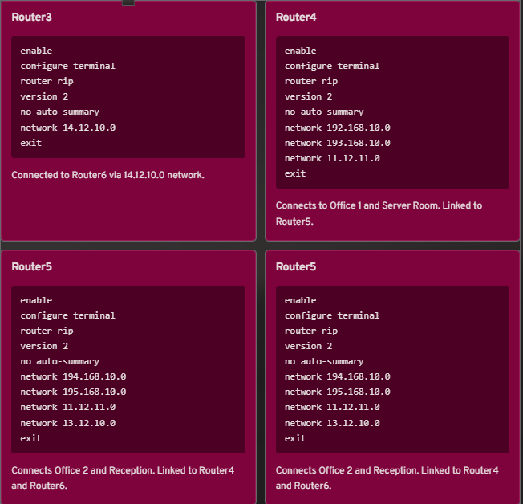
Router Configuration with RIP v2
We configured each router using RIP version 2. This protocol enables automatic route sharing. It ensures efficient network communication.

Slide 8
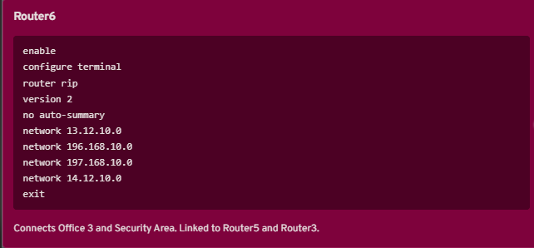

Slide 9




Router Configuration Details
Each router was configured with RIP v2 to enable seamless and automatic route sharing across the network.
Router3
Router4
Configured with network 14.12.10.0. This connects it directly to Router6.
Supports networks 192.168.10.0, 193.168.10.0, and 11.12.11.0. This connects to Office 1, Server Room, and Router5.
Router5
Router6
Manages networks 194.168.10.0, 195.168.10.0, 11.12.11.0, and 13.12.10.0. This connects to Office 2, Reception, Router4, and Router6.
Handles networks 13.12.10.0, 196.168.10.0, 197.168.10.0, and 14.12.10.0. This connects to Office 3, Security Area, Router5, and Router3.

Slide 10
IP Configuration Summary
Consistent IP planning ensures every device communicates effectively within the network structure.
Office 1
PC
192.168.10.10
255.255.255.0
192.168.10.1
Office 2
PC
195.168.10.11
255.255.255.0
195.168.10.1
Office 3
PC
196.168.10.12
255.255.255.0
196.168.10.1
Server Room
Server
193.168.10.100
255.255.255.0
193.168.10.1
Security Area
PC
197.168.10.13
255.255.255.0
197.168.10.1
Office 2
Printer
194.168.10.50
255.255.255.0
194.168.10.1

Slide 11

Final Results: A Fully Functional Network
Device Communication
All network devices successfully communicate. This confirms robust connectivity across different offices.
Ping Verification
Ping tests between PCs, printers, and servers were successful. This validates seamless data transfer.
Dynamic Routing
RIP-based routing ensures dynamic and hassle-free communication. This eliminates manual route configuration.
IP Phone Functionality
IP phones work perfectly where configured. This adds voice communication capabilities.
Real-World Simulation
The project successfully simulates a real-world office network. This provides valuable practical experience.

Slide 12




AFTER TESTING

Slide 13

Conclusion: A Scalable & Secure Office Environment
This network simulation proves the feasibility of implementing a scalable, secure, and interconnected office environment. We leveraged Cisco Packet Tracer for comprehensive design and testing.
Through meticulous IP planning, utilizing dynamic routing protocols like RIP v2, and precise switch and router configurations, we achieved end-to-end connectivity across all departments in a simulated real-time setup. This project offers a strong foundation for future network expansions and enhancements.

